Slide 1
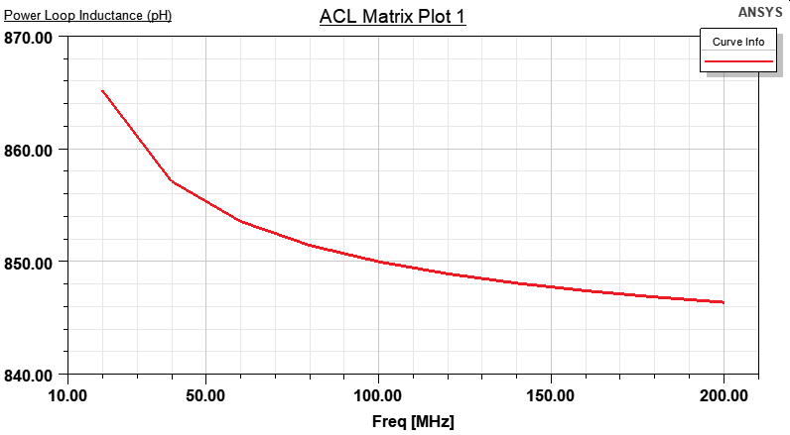
Power Loop Analysis
Previous week
Results
DC Analysis | Inductance | 2.68 nH
AC Analysis (200 MHz) | Inductance | 0.84 nH
Results for AC and DC solutions
This week
Results
DC Analysis | Inductance | 2.68 nH
AC Analysis (1 Hz) | Inductance | 0.863 nH
Frequency sweep from 20MHz to 200MHz
Clearly indicates a calculation method difference between AC and DC solutions

Slide 2
Power Loop Analysis
Previous week
Results
DC Analysis | Inductance | 2.68 nH
AC Analysis (200 MHz) | Inductance | 0.84 nH
Basic Assumptions
The following basic assumptions are made in 2D Extractor:
You are only trying to model quasi-TEM wave effects (structures with two or more conductors).
The transmission line has a uniform cross-section along its length, and can therefore be represented by a single cross section. Discontinuities associated with bends, junctions, and vias are not taken into account by the software. To model the effect of such discontinuities, use the Q3D Extractor (for low to middle frequencies) or HFSS (for high frequencies), which allow you to draw and analyze a full three-dimensional model of a structure.
All electric and magnetic fields lie in the XY cross-section being modeled — no component of the E-field or B-field lies in the direction of propagation, except possibly for a small electric field component due to conductor losses.
Results for AC and DC solutions
This week
Results
DC Analysis | Inductance | 2.68 nH
AC Analysis (1 Hz) | Inductance | 0.863 nH
Clearly indicates a calculation method difference between AC and DC solutions

Slide 3
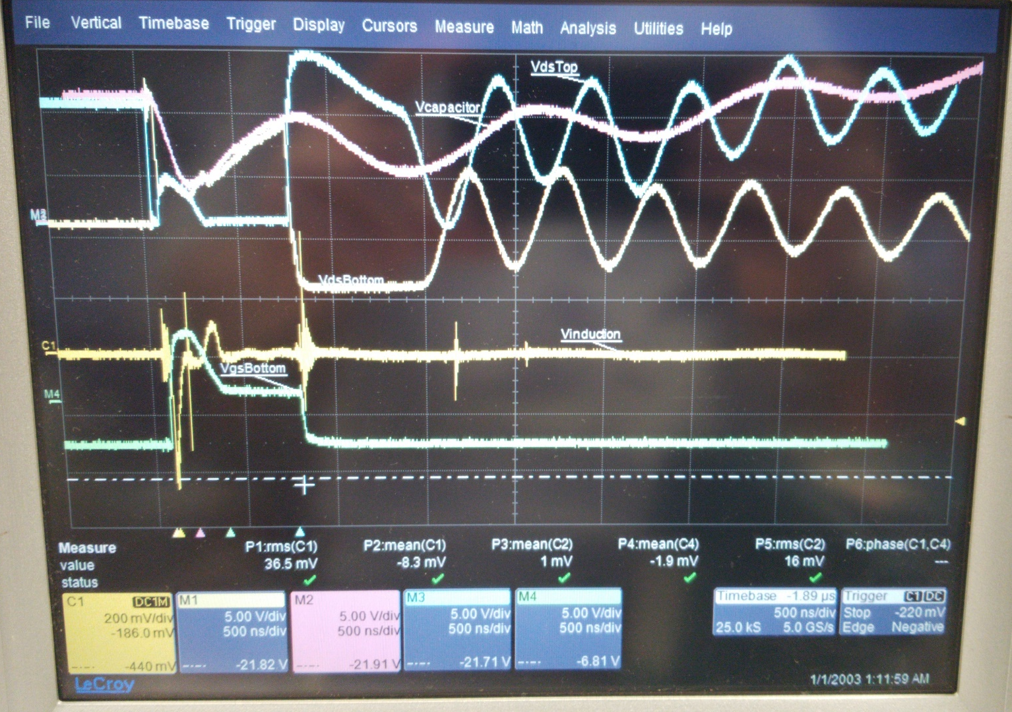
Short Circuit Protection (SCP) Mechanism
~0.55V Threshold
Single Bridge Configuration
An example view under 10V

Slide 4
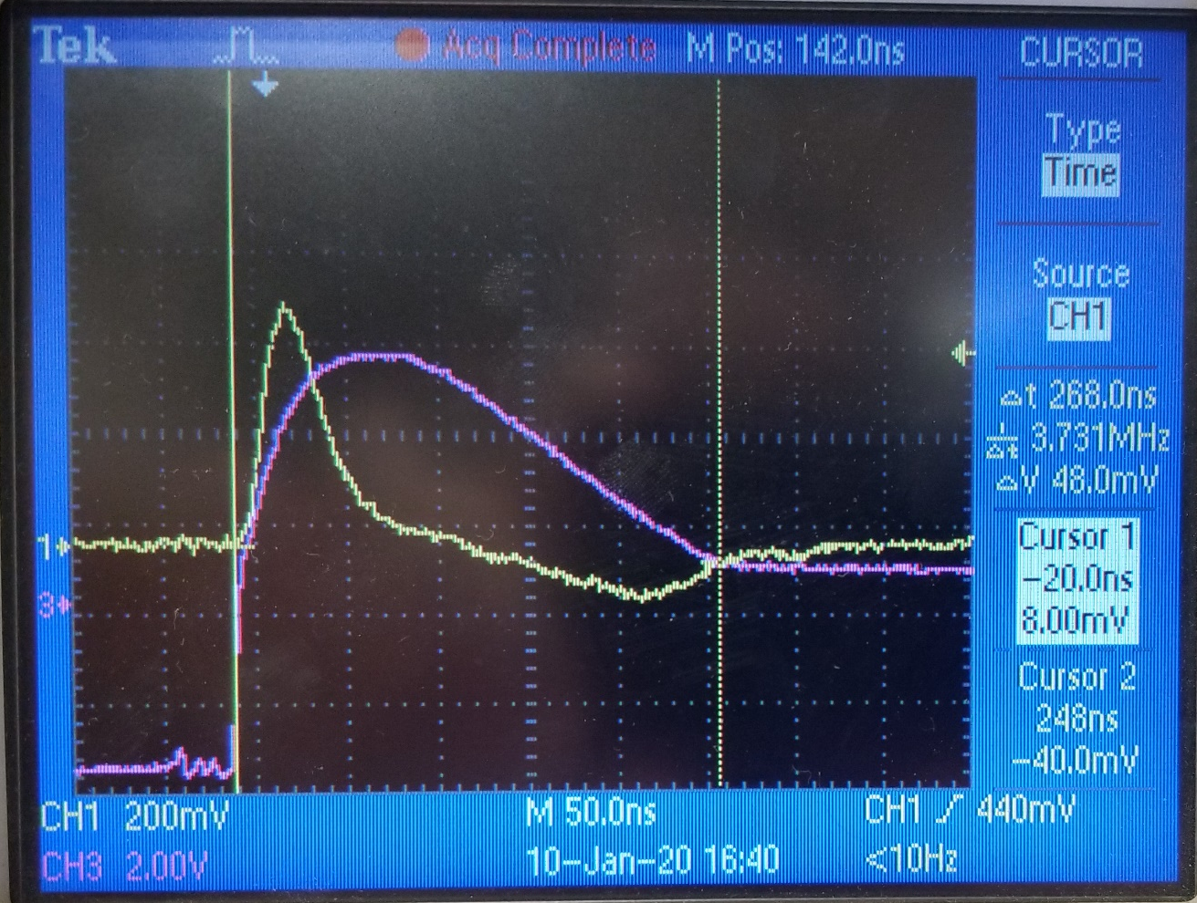
Short Circuit Protection (SCP) Mechanism
Timings of self-triggered SCP mechanism
SC start – SC sense: 30 nsec
SC sense – Start of discharge: 68 nsec
Start of discharge – End of discharge: 170 nsec
In total
SC start – End of discharge: 268 nsec
Full time scope of a SCP Mechanism
Yellow -> Induced voltage
Pink -> Gate-source voltage

Slide 5
Single Bridge DPT Results

Slide 6
Single Bridge DPT Results
Control switch waveforms
No DC waveforms are 0.5V lower than actual
Non-problematic noise

Slide 7
Single Bridge DPT Results
Control switch waveforms
DC Voltage | Overshoot Level
25 | 36 (44%)
50 | 68 (36%)
75 | 96 (28%)
100 | 142 (42%)

Slide 8
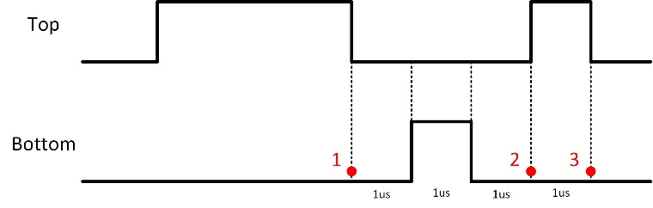
Single Bridge DPT Results
Synchronous switch waveforms
No DC waveforms are 0.5V lower than actual
Unintended rise on gate-source voltage: False turn-on (Safe)
Short-circuit detection (Probably False)

Slide 9

Single Bridge DPT Results
Synchronous switch waveforms
High inductance, alone capacitance?
Quite interesting discharge
What about the crest factor of current?
$$X_{c}=\frac{I_{peak}}{I_{rms}}$$

Slide 10
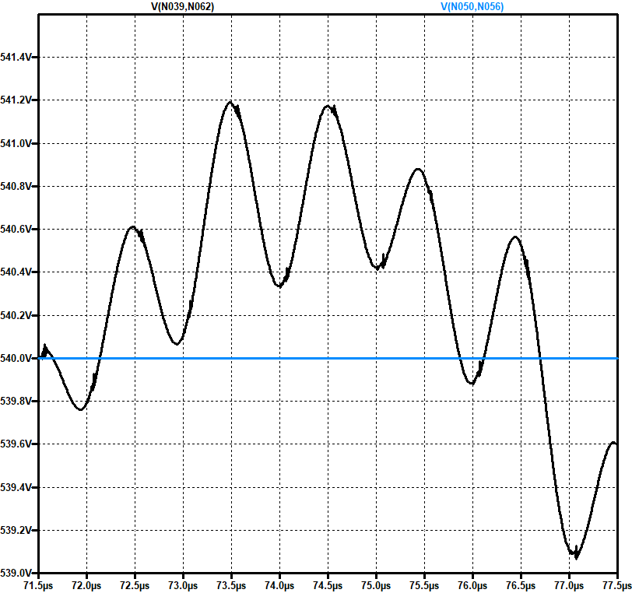

Buck Converter Simulation
Buck converter is not affected that much because crest factor of current is quite low
Even though the peak current is higher for a switching period of a buck converter, the RMS current is high. For DPT case, current is not drawn continously, so the RMS value is extremely low. High amount of current is drawn for a very short period.
$$\sim 1V$$

